Slide 1

SIGN SPEAK
Mentor:
Mr. V. Maruthu Pandi M.E,
Assisstant Professor CSE,
Computer Science and Engineering,
Kalasalingam Academy of Research and Education,
Krishnan kovil - 626126
Done by
T. LEENA
99220040371
SLOT 1, S-27
2nd Year B. Tech (CSE)

Slide 2
INTRODUCTION
Sign Language is mainly used by deaf (hard hearing) and dumb people to exchange information between their own community and with other people.
It is a language where people use their hand gestures to communicate as they can’t speak or hear.
Sign Language Recognition (SLR) deals with recognizing the hand gestures acquisition and continues till text or speech is generated for corresponding hand gestures
Sign language translation, also known as sign language interpretation, plays a crucial role in facilitating communication between sign language users and non-signers.

Slide 3
ABOUT SOFTWARE TOOL
Developing software for sign language recognition involves a combination of techniques from computer vision, machine learning, and signal processing.
Here are some popular software tools and libraries used for sign language recognition:
OpenPose
MediaPipe
TensorFlow and PyTorch
OpenCV
Scikit-learn
Deepsign
Sign Language MNIST Dataset
Microsoft Kinect SDK

Slide 4
USAGE TOOL
The tools used in this project is
MediaPipe
TensorFlow
OpenCV
MediaPipe:
MediaPipe, developed by Google, is a framework for building cross-platform applied ML pipelines.
It offers solutions for various perception tasks, including hand tracking, gesture recognition, and facial landmark detection, which are useful for sign language recognition applications.

Slide 5
Contd..
TensorFlow :
TensorFlow is popular deep learning frameworks that provide tools for building and training neural networks.
They offer pre-trained models and APIs for tasks such as image classification, object detection, and pose estimation, which can be adapted for sign language recognition tasks.
OpenCV:
OpenCV (Open Source Computer Vision Library) is a popular library for computer vision tasks.
It provides a wide range of functions and algorithms for image and video processing, including feature detection, object tracking, and motion analysis, which are useful for sign language recognition systems.

Slide 6
LITERATURE REVIEW
Real-time sign language fingerspelling recognition using convolutional neural networks from depth map:
This works focuses on static fingerspelling in American Sign Language.
A method for implementing a sign language to text/voice conversion system without using handheld gloves and sensors, by capturing the gesture continuously.
In this method, only a few images were captured for recognition.
The design of a communication aid for the physically challenged.

Slide 7
OBJECTIVE OF PROJECT
The main objectives of this project are to contribute to the field of automatic sign language recognition and translation to text.
In our project, we focus on static sign language hand gestures. This work focused on recognizing the hand gestures which includes alphabets and numbers.
We created a convolution neural networks classifier that can classify the hand gestures into English alphabets and digits.

Slide 8
TIMELINE OF WORK PROPOSAL
Modules | Week 1 | Week 2 | Week 3 | Week 4
Selecting the problem statement | Completed
Working on the problem statement |  | Completed
Debugging the code |  |  | Completed
Completing the output |  |  |  | Completed

Slide 9
USED ALGORITHM
Sign language detection involves several algorithms and techniques from computer vision and machine learning to recognize and interpret sign language gestures.
Here are some common algorithms and approaches used in sign language detection:
Hand Detection and Tracking,
Hand Gesture Recognition,
Feature Extraction,
Gesture Classification.

Slide 10
WORKDONE
Importing libraries
Importing Dataset
Data loading and Preprocessing
Hand detection
Feature extraction
Gesture representation

Slide 11
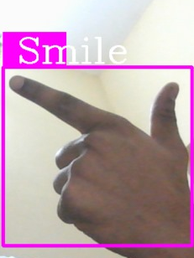
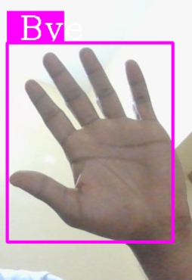
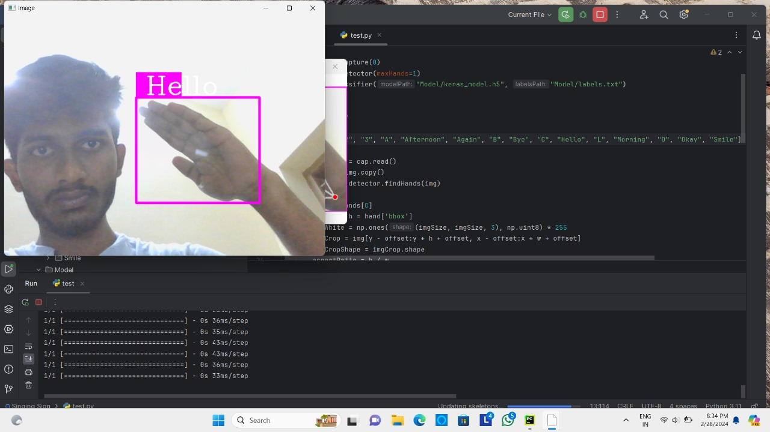
RESULTS

Slide 12
CONCLUSION
In conclusion, we were successfully able to develop a practical and meaningful system that can able to understand sign language and translate that to the corresponding text.
From hand detection and tracking to gesture recognition and post-processing, each step in the process contributes to the overall accuracy and reliability of the system.
In essence, sign language detection represents not only a technological achievement but also a testament to the power of innovation in fostering communication, understanding, and connection across linguistic and cultural barriers.

Slide 13
REFERENCE
Songyao Jiang, Bin Sun, Lichen Wang, Yue Bai, Kunpeng Li, and Yun Raymond Fu. 2021. Skeleton aware multi-modal sign language recognition. IEEE/CVF Conference on Computer Vision and Pattern Recognition Workshops (CVPRW).
Ninoslava Kuhn, Tamara Ciciliani, and Ronnie Wilbur. 2006. Phonological parameters in croatian sign language. Sign Language & Linguistics.
Sruthi Upendran, Thamizharasi. A,” American Sign Language Interpreter System for Deaf and Dumb Individuals”, 2014 International Conference on Control, Instrumentation, Communication and Computa.

Slide 14
Thank you

